Slide 1
MODULE- 2

Slide 2
Module- 2 (Organizing Content and Information Architecture)
Introduction to information architecture and application structure - Exploring patterns for feature organization, search, and browsing. Organizing content in Bootstrap 5- images, cards, lists, and tables.

Slide 3
Information architecture (IA) & Application structure
Information architecture (IA) is the art of organizing an information space. It encompasses many things: presenting, searching, browsing, labeling, categorizing, sorting, manipulating, and strategically hiding information.
Especially if you’re working with a new product, this is where you should start.
Application structure refers to the overall architecture of an application, including how different components interact and how information flows within the system. It encompasses both the technical and user-facing aspects of an application.

Slide 4
Introduction to information architecture and application structure
At the highest level of application design, it's essential to consider the various functions of sites or app serves, such as providing software services, sharing information, selling products, branding, and facilitating social communication. The home page should effectively guide users to their desired areas through clear text and imagery.
Key decisions at this level include
selecting an interaction model
whether to use a desktop metaphor
a traditional website layout, or a more interactive approach.
This model ensures consistency and defines how users navigate through different functionalities.

Slide 5
When focusing on smaller units within the application, such as pages dedicated to specific functions, each page typically serves one of four primary purposes:
Displaying a single item (e.g., a map or video).
Presenting a list or collection of items.
Offering tools for creation (e.g., a document editor).
Facilitating a specific task (e.g., a registration form).
Most apps combine these functions, and each part should be designed to fit its main purpose. This follows Theresa Neil's framework, which organizes app structures based on user goals: information, process, and creation.

Slide 6
Displaying a single item
The primary focus of your page's design is to showcase or play a single piece of content without distractions
Key Considerations:
Your main task is to manage user interaction with this singular piece of content.
The Information Architecture (IA) is likely straightforward, with minor tools surrounding the content (e.g., scrollers, sliders, sign-in boxes, global navigation, headers, and footers).

Slide 7
Displaying a single item
Possible Design Shapes:
Long, Vertically Scrolled Page: Ideal for articles, books, and other long-form content.
Zoomable Interface: Suitable for large, detailed artifacts like maps or images (e.g., Google Maps).
Media Player Idiom: For video and audio content.
Design Patterns and Techniques to support design:
Alternative Views: Offer multiple ways to present the content.
Many Workspaces: Allow users to view multiple states or documents simultaneously.
Deep-linked State: Enable users to save specific locations within the content for easy return or sharing via URL.
Sharing Widget: Incorporate social sharing features.
Mobile Patterns: Consider mobile-friendly designs if targeting mobile device users.

Slide 8
Presenting a list or collection of items
Common List Formats: Digital artifacts often utilize various list formats, including text lists, menus, image grids, search results, email threads, tables, and trees.
Lists present rich challenges in information architecture.
Information Architecture Challenges:
Length of the list
Flat vs. hierarchical structure
Ordering and dynamic reordering options
Filtering and searching capabilities
Associated information or operations for each item

Slide 9
Presenting a list or collection of items
Design Patterns:
Feature, Search, and Browse: Common in e-commerce and content sites, allowing users to search or browse items, with a featured item on the front page.
News Stream: Used by blogs and social media, displaying the most recent updates at the top.
Picture Manager: A specialized interface for managing photos, supporting both hierarchical and flat lists, with tools for arrangement and direct operations on images.
Integration of Techniques: Once a primary design pattern is chosen, consider additional techniques (e.g., Thumbnail Grid, Pagination) to enhance list presentation within the selected framework

Slide 10
Offering tools for creation
Key Examples: Microsoft Office Suite (Word, Excel, PowerPoint), Adobe Creative Suite (Photoshop, Illustrator, InDesign, Dreamweaver), and various code editors/IDEs.
At the level of application structure or IA, the following patterns are often found to design different aspects of these tools
Canvas Plus Palette: A recognizable pattern for visual editors that sets strong user expectations.
Many Workspaces: Allows users to manage multiple documents in parallel through separate windows.
Alternative Views: Enables users to view a single document through different perspectives.
Blank Slate Invitation: Encourages users to start new projects with a clean slate, enhancing creativity and usability.

Slide 11
Facilitating a specific task
User Interface Design for Task Completion
Signing in, registering, posting, printing, uploading, purchasing, changing a setting—all such tasks fall into this category.
The interface should prioritize getting tasks done
Role of Forms: Forms are essential for facilitating user tasks.
Task Complexity:
For simple tasks, a contained area (like a sign-in box) suffices.
For more complex tasks (long, branched, or with many options), it's important to structure the task effectively.
Breaking Down Tasks:
Consider using a Wizard for guiding users through multi-step tasks.
Settings Editor:
This interface allows users to change settings/preferences without a step-by-step approach. Users should have open access to various options and be able to navigate freely.

Slide 12
The Patterns
Interface patterns that define interactions for significant parts of applications or websites.
Patterns like Picture Manager, Canvas Plus Palette, and Feature, Search, and Browse are "guilds" of smaller patterns, working together to provide comprehensive functionality and user experience across large sections or entire sites.

Slide 13
The Patterns
1. Feature, Search, and Browse
2. News Stream
3. Picture Manager
4. Dashboard
5. Canvas Plus Palette
6. Wizard
7. Settings Editor
The last three patterns are more “meta,” in the sense that they can apply to the other patterns in the preceding list
8. Alternative Views
9. Many Workspaces
10. Multi-Level Help

Slide 14
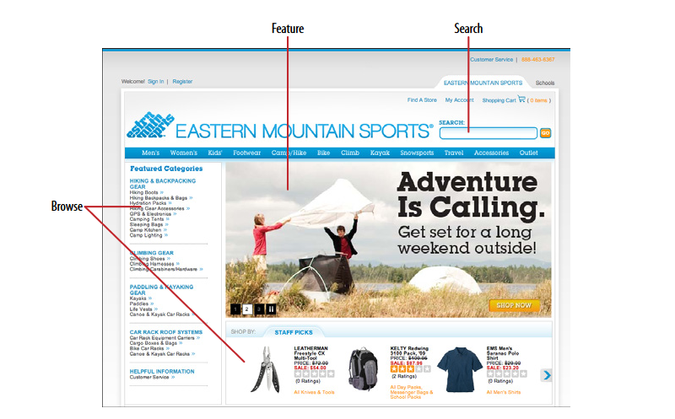
1. Feature, Search, and Browse
Put three elements on the main page of the site or app: a featured article or product, a search box, and a list of items or categories that can be browsed
This approach helps users quickly find engaging content and encourages them to explore more of what your site has to offer.

Slide 15
1. Feature, Search, and Browse - WHY
Successful sites often use three key elements together: search ,browsing options, and featured items.
Search lets users find exactly what they want.
while browsing helps them discover new things.
Featured items grab attention with appealing images and headlines, giving users something interesting to engage with right away.
This approach can make users more interested in your site and keep them exploring.
A user who lands on a page now has something to read or experiment with, without doing any additional work at all and he may find it more interesting than whatever he originally came for.

Slide 16
1. Feature, Search, and Browse- HOW
Place the search box in a prominent spot, like the top corner or across the top of the page. Use whitespace and a different background color to make it stand out and avoid confusion with other text fields.
Set aside Center Stage for the featured article, product, or video. Very near it, and still above the fold, place an area for browsing the rest of the site’s content.
Use lists, menus, or expandable categories to help users explore more easily.
If the category labels open in place to show subcategories, the list behaves like a tree. Some sites, such as Amazon, turn the category labels into menus: when the pointer rolls over the label, a menu of subcategories appears.

Slide 17
1. Feature, Search, and Browse- HOW
Choose your featured items carefully.
Features are a good way to sell items, advertise specials, and call attention to breaking news.
However, they also define what your site is about.
They should reflect your site's values and interests—whether that's promoting products, specials, or charitable efforts.
Understand what your users care about and what will keep them engaged with your site.

Slide 18
2. News Stream- WHAT & WHEN
Display , time-sensitive items in a reverse chronological order, with the latest at the top.
Update the list dynamically and combine items from various sources into a single stream.
Your site or app uses communication channels like blogs, email, social media, or news updates to deliver timely content.

Slide 19
2. News Stream- WHY
News streams are easy to follow because the latest items always appear at the top automatically.
They can check in often and be assured of seeing what they need to see
People visit various sites and apps daily to stay updated on friends, conversations, or topics of interest. Combining multiple news sources into one place makes it easier to keep track of everything. This aligns with the Microbreaks pattern, allowing users to get a lot of information quickly and effortlessly.
For publishers, including a News Box or similar feature on your main page helps visitors see the latest updates and important content, such as new products, blog posts, videos, news, and other initiatives. This is especially useful for large organizations with many ongoing activities.

Slide 20
2. News Stream- HOW
To help users keep up with multiple news sources easily, follow these guidelines:
Display Items: List news items in reverse chronological order, with the newest at the top. If possible, automatically update the list with new items and provide an option to manually refresh.
Organize Streams: For busy feeds, break content into sub streams by topic, sender, or other factors. Allow users to choose which sub streams they want to view.
Information to Include:
What: Show the full micro-update or, for longer content, include a title, brief teaser, and thumbnail image.
Who: Display the name of the author or source, balancing personal names with institutional names.
When: Provide a date or timestamp, and consider using relative times like “Yesterday” or “11 minutes ago.”
Where: Link to the source of the item, or show geolocation data if applicable.

Slide 21
2. News Stream
For handling content in a News Stream:
Expand Content: If an item is too long to display fully, include a “More” link or button to view the entire content. Consider using Two-Panel Selector, One-Window Drilldown, or List Inlay methods to show additional details.
Encourage Interaction: Allow users to quickly respond to items with actions like stars, thumbs-up, likes, or favorites. Also, provide options for longer replies and place these controls next to each item to promote engagement.
Enable Sharing: Facilitate easy sharing of items via email or social media.
Mobile Design: On mobile devices, use a full-screen list, often a Thumbnail-and-Text List, where users can tap or click to view items in detail. Infinite List patterns, which load more content as users scroll, are common in mobile and full-screen designs.
Activity Streams: Note that activity streams focus on time-ordered actions performed by entities (individuals, systems, or organizations), while News Streams aggregate diverse sources of interest to users.

Slide 22
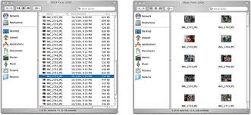
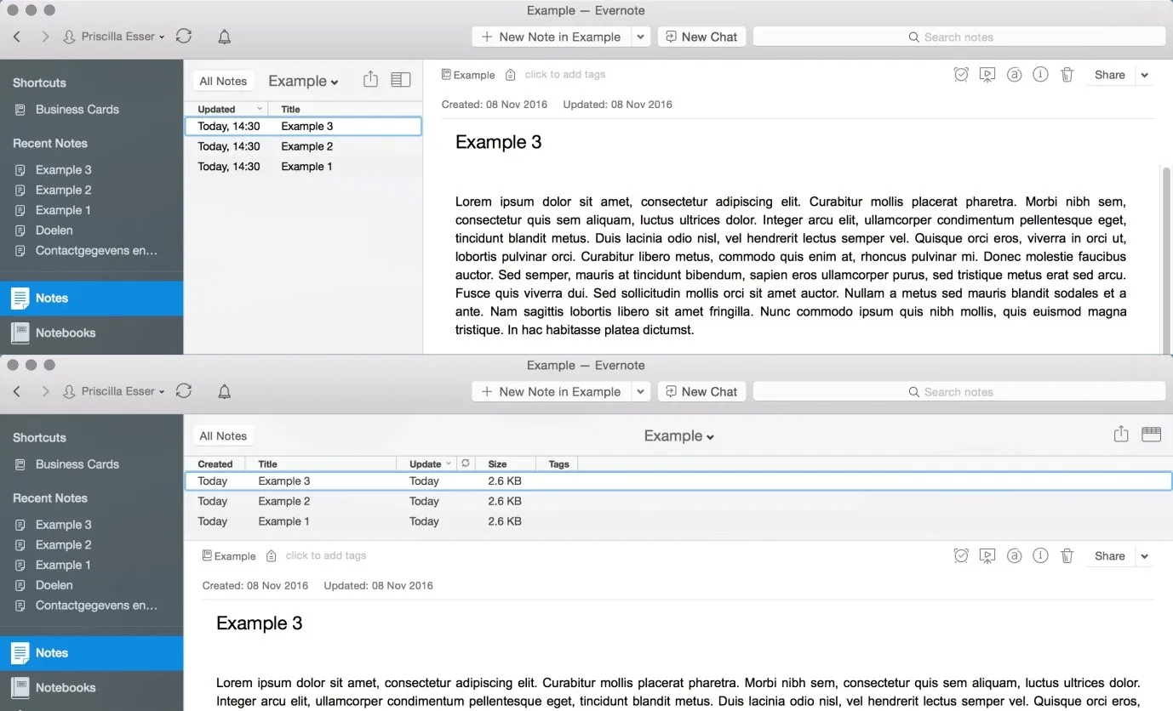

Slide 23
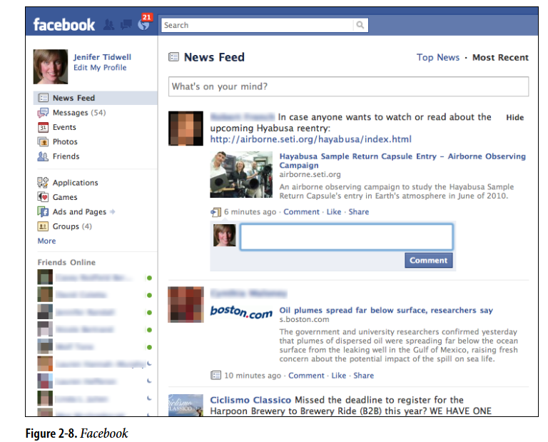
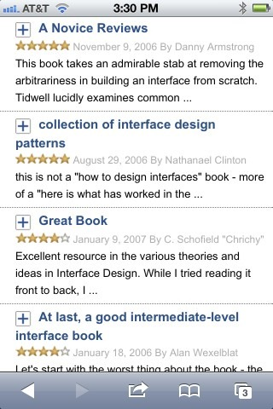

Slide 24
3.Picture Manager- WHAT & WHEN
Use thumbnails, item views, and a browsing interface to create a familiar structure for managing photos, videos, and other pictorial items.
People use your software to work with lists or collections of pictorial things: photos, drawings, video clips, and so on.
The list might be in a web page, or in an application, or both.
It might allow editing by the owner of the content, or it might simply show the content to the public for browsing, viewing, and comments.

Slide 25
Picture Manager- HOW
Set up two principal views:
Thumbnail Grid of the items in the list
large view of a single item.
Users will go back and forth between these.
Design a browsing interface and associate it with the Thumbnail Grid to let users explore a large collection easily.

Slide 26
THUMBNAILS
Use the Thumbnail Grid to display a sequence of items
Many Picture Managers show a small amount of metadata with each item, such as its filename or author, and it offer a control to adjust the size of the thumbnails.
There may also be a way to sort the items by different criteria, such as date, label, or rating, or to filter it and show only the starred items (for instance).
When a user clicks on an item, show it immediately in the single-item view.

Slide 27
THUMBNAILS
If the user owns the items, offer ways to move, reorder, and delete items at this level in the interface.
Cut, copy, and paste should also work in applications

Slide 28
Single-Item View
The Single-Item View provides a detailed, large view of a selected item (image or video), along with relevant metadata and additional features.
Layout Options:
Two-Panel Selector: Use this layout to show the Single-Item View alongside the Thumbnail Grid if screen space allows.
One-Window Drilldown: Replace the Thumbnail Grid with the Single-Item View for a more focused experience on smaller screens.

Slide 29
Single-Item View
Editing features for individual items will live here, also. For instance, a photo manager might offer simple functionality such as cropping, color and brightness adjustment, and red-eye reduction
Use Button Groups to maintain a simple, comprehensible visual grouping of all these features.
If the interface is web-based, consider adding social features in the Single-Item View. This can include options for users to comment, like, or share the item, as well as tag or label it either privately or publicly.
Additionally, providing a recommendation feature for “other items you may like” can enhance the browsing experience and encourage further exploration.

Slide 30
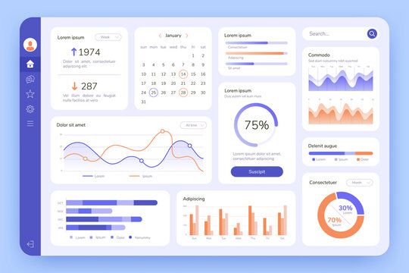
4. Dashboard
Dashboard is a type of graphical user interface which often provides at-a-glance views of data relevant to a particular objective or process through a combination of visualizations and summary information
Arrange data displays into a single information-dense page, updated regularly.
Show users relevant, actionable information, and let them customize the display as necessary

Slide 31
Dashboards are a well-known and familiar page style, both online and offline. They display useful information and update automatically.
Typically, they use graphics like charts and graphs to present data in an easy-to-understand way.
To design an effective dashboard, follow these steps:
Identify Key Information: Determine what users need or want to see.
Use Visual Hierarchy: Arrange information clearly using lists, tables, and graphics. Keep important data visible on one page without excessive scrolling.
Enable Drilldown: Allow users to click on elements to view more details. Datatips work well to show individual data points when the pointer rolls over an information graphic.

Slide 32
4. Choose the Right Graphics: Use simple line and bar charts for comparing data, especially over time. For numbers and text, use lists and tables.
5. Highlight Key Information: Make important text and numbers stand out so users can quickly spot actionable information
6. Allow Customization: Letting them rearrange sections and select which widgets or gadgets to display.

Slide 33
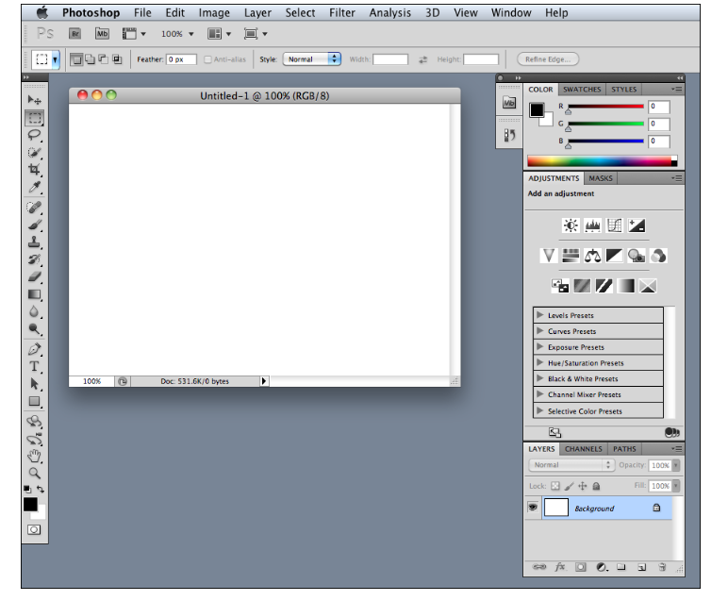
5. Canvas Plus Palette
Place an iconic palette next to a blank canvas; the user clicks on the palette buttons to create objects on the canvas.

Slide 34
This pair of panels
a palette for choosing tools
a canvas for creating
are common in desktop software.
They mirror real-life objects, making them easy to understand.
The palette uses familiar icons, like paintbrushes and magnifying glasses, which are consistently used across different applications.

Slide 35
Create a large empty area as the canvas where users can work. This canvas can be in its own window or part of a page with other tools. Place the canvas next to a palette that contains tool icons.
The palette should have a grid of buttons with icons, and text if needed, to make it clear what each button does. Position the palette to the left or top of the canvas, and you can organize it with tabs or collapsible panels.
Most buttons on the palette will directly create items on the canvas. However, you can also include functions like zoom or selection tools. Different applications use various methods to interact with the palette, such as drag-and-drop or clicking, so testing these interactions is crucial to ensure usability.

Slide 36
6. Settings Editor
Provide an easy-to-find, self-contained page or window where users can change settings, preferences, or properties.
A user must be able to find and edit a desired property without being forced to walk through a prescribed sequence of steps—random access is important.
To aid findability, the properties should be grouped into categories that are well labeled and make immediate sense.
Another important aspect of Settings Editor design is that people will use it for viewing existing settings, not just changing them. The design needs to communicate the values of those settings at a glance.

Slide 37
To design an effective settings editor:
Make It Findable: Place settings in standard locations. For apps, follow common conventions; for websites, put account and profile links where the username is, usually in the upper-right or -left corner.
Organize Properties: Use card sorting with users to determine these groups and their names. Avoid deep hierarchies that require too many clicks to navigate.
Choose a Layout: Use common layouts like tabs, two-panel selectors, or one-window drilldowns
Form Design: patterns and techniques for designing forms.
Apply Changes: Decide whether to apply changes immediately or use Save and Cancel buttons based on the type of settings and established conventions. Test with users to determine the best approach.

Slide 38
7. Alternative Views
Let the user choose among alternative views that are substantially different from the default view.
If you're building a tool for viewing or editing complex content, you may already offer basic customizations like font size or zoom level.
However, if you need to accommodate more complex needs or conflicting requirements, you have to provide different design with different feature sets. Let users choose between these versions to meet their specific needs.

Slide 39
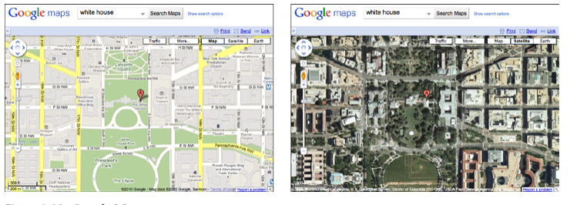

Slide 40
WHY
There are several reasons for Alternative Views:
Users have preferences with regard to speed, visual style, and other factors.
A user might need to temporarily view data through a different “lens” or perspective in order to gain insight into a problem.
If a user is editing a slideshow or website, for instance, he may do most of his editing while using a “structural” view of the document, containing editing handles, markers for invisible content, layout guides, private notes, and so on. But sometimes he will want to see the work as an end user would see it.

Slide 41
HOW
Design specialized views for the scenarios, and present them as alternatives within the same window or screen.
In these alternative views, some information might be added and some might be taken away, but the core content should remain more or less the same.
A common way to switch views is to change the rendering of a list; file finders in both Windows and Mac OS let users switch from lists to Thumbnail Grids to Tree Tables to Cascading Lists to Carousels, for instance.

Slide 42
HOW
Most applications represent the alternative views with iconic buttons.
As the user switches back and forth, preserve all of the application’s current state selections, the user’s location in the document, uncommitted changes, undo/redo operations, and so on .
If a user decides to switch to an alternative view, the application will just use that view by default next time.
Websites can do this by using cookies; desktop applications can keep track of preferences per user; an app on a mobile device can simply remember what view it used the last time it was invoked.
Web pages may have the option of implementing Alternative Views as alternative CSS pages.

Slide 43
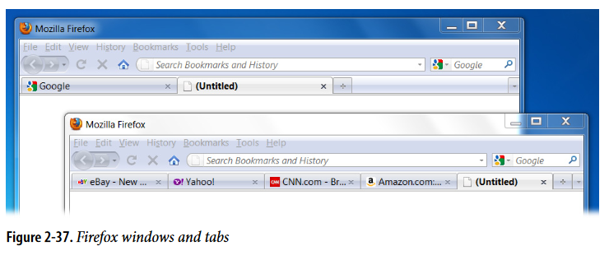
Many Workspaces
Use multiple top-level tabs, tab groups, and windows so that users can view more than one page, project, file, or context at a time.
Let users place these workspaces side by side if possible.

Slide 44
WHY
People multitask.
They go off on tangents, abandon trains of thought, stop working on task A to switch to task B, and eventually come back to something they left hanging.
One way or the other, they will multitask, so you might as well support it directly with a well- designed interface for doing so.
Side-by-side comparisons between two or more items can help people learn and gain insight.
Let users pull up pages or documents next to each other without having to laboriously switch context from one to another.
This pattern directly supports some patterns, such as Prospective Memory (a user may leave a window open as a self-reminder to finish something) and Safe Exploration

Slide 45
HOW
Choose one or more ways to show multiple workspaces.
Many well-known applications use the following:
Tabs
Separate operating-system windows
Columns or panels within a window
Split windows, with the ability to adjust the splitters interactively
If you deal with fairly simple content in each workspace such as text files, lists, or News Streams split windows or panels work fine.
More complex content might warrant entire tab pages or windows of their own so that a user can see a larger area at once.

Slide 46
When users close some web browsers, such as Chrome, the set of workspaces (all open web pages, in tabs and windows) gets automatically saved for later use.
Then when the user restarts the browser, her entire set of previously opened web pages is restored, almost as she left it. This is especially nice when the browser or machine has crashed.

Slide 47
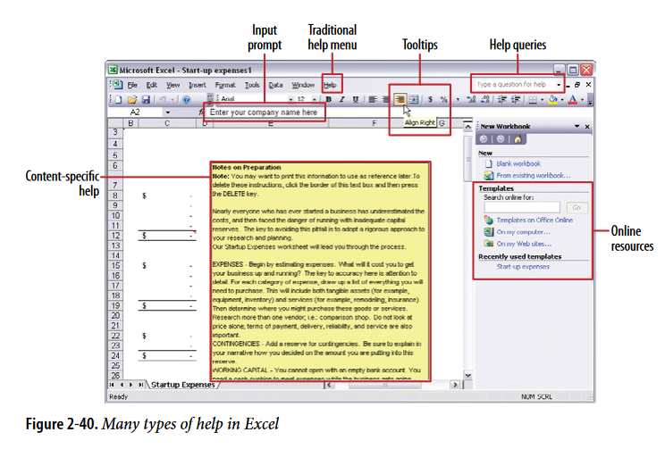
Multi-Level Help

Slide 48
Multi-Level Help
Use a mixture of lightweight and heavyweight help techniques to support users with varying needs
When designing a complex application, it's crucial to support both beginners and experienced users effectively.
Some users may need a full-fledged help system, but most users won’t take the time to use it

Slide 49
Multi-Level Help- WHY
Users of almost any software artifact need varying levels of support for the tasks they’re trying to accomplish.
Someone approaching it for the first time ever (or the first time in a while) needs different support than someone who uses it frequently.
Even among first time users, enormous differences exist in commitment level and learning styles.
Some people want to read a tutorial, some won’t; most find tool tips helpful, but a few find them irritating

Slide 50
Multi-Level Help- WHY
Help texts that are provided on many levels at once even when they don’t look like traditional “help systems” reach everyone who needs them.
Many good help techniques put the help texts within easy reach, but not directly in the user’s face all the time, so users don’t get irritated.

Slide 51
Multi-Level Help- HOW
Captions and instructions directly on the page, including patterns such as Input Hints and Input Prompt
Tool tips. Use them to show very brief, one- or two-line descriptions of interface features that aren’t self-evident
Hover Tools. These can display slightly longer descriptions, shown dynamically as the user selects or rolls over certain interface elements.
Longer help texts contained inside Collapsible Panels
Introductory material, such as static introductory screens, guided tours, and videos.
Help shown in a separate window, often in HTML via browsers, but sometimes in WinHelp or Mac Help.
Live” technical support, usually via email, the Web, Twitter, or telephone.
Informal community support

Slide 52
BOOTSTRAP
`

Slide 53
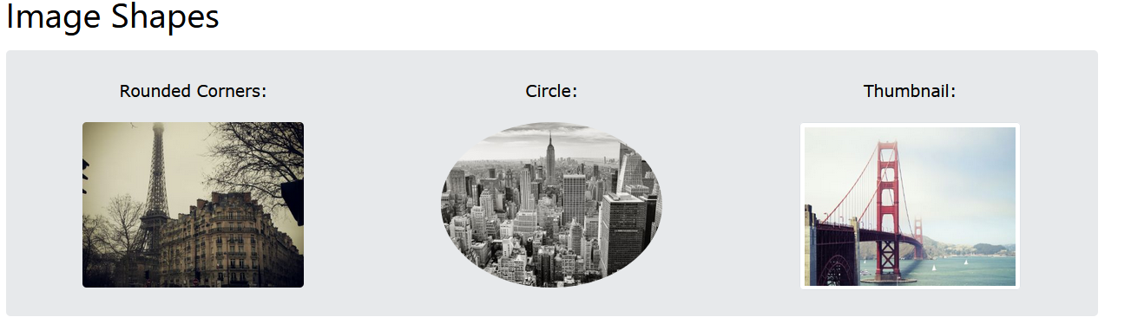
BOOTSTRAP -Responsive images
Images come in all sizes. So do screens. Responsive images automatically adjust to fit the size of the screen.
Images in Bootstrap are made responsive with .img-fluid. This applies max-width: 100%; and height: auto; to the image so that it scales with the parent element.
<img src="..." class="img-fluid" alt="...">

Slide 54
IMAGE SHAPES
The .rounded class adds rounded corners to an image
<img src="cinqueterre.jpg" class="rounded" alt="Cinque Terre">
The .rounded-circle class shapes the image to a circle:
<img src="cinqueterre.jpg" class="rounded-circle" alt="Cinque Terre">
The .img-thumbnail class shapes the image to a thumbnail (bordered):
<img src="cinqueterre.jpg" class="img-thumbnail" alt="Cinque Terre">

Slide 55
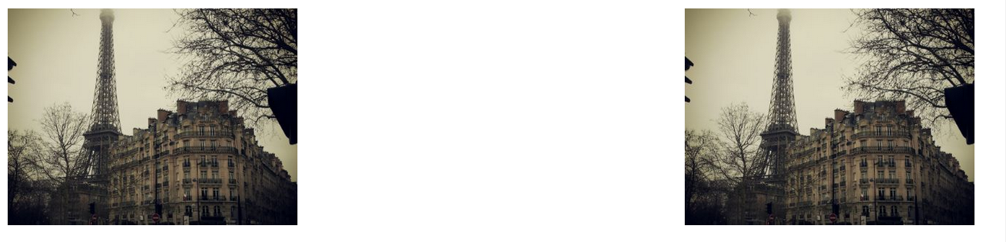
Aligning Images
Float an image to the left with the .float-start class or to the right with .float-end
<img src="paris.jpg" class="float-start"> <img src="paris.jpg" class="float-end">

Slide 56
Aligning Images
Center an image by adding the utility classes .mx-auto (margin:auto) and .d-block (display:block) to the image
<img src="paris.jpg" class="mx-auto d-block">
<img src="..." class="rounded mx-auto d-block" alt="...">

Slide 57
Sass- Variables
Variables are available for image thumbnails.
$thumbnail-padding: .25rem;
$thumbnail-bg: $body-bg;
$thumbnail-border-width: $border-width;
$thumbnail-border-color: $gray-300;
$thumbnail-border-radius: $border-radius;
$thumbnail-box-shadow: $box-shadow-sm;

Slide 58
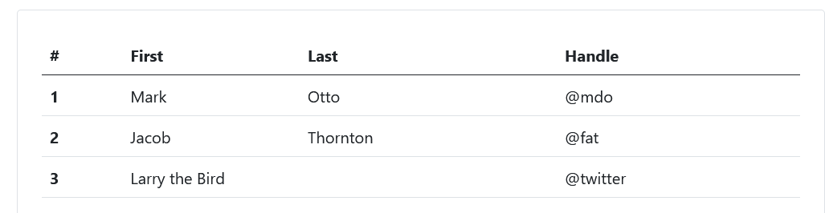
Tables
In Bootstrap, tables use the .table class for styling.
Since many third-party widgets like calendars use <table> elements, Bootstrap's table styles are not applied automatically.
To style a table with Bootstrap, just add the .table class to it.
<table class="table">

Slide 59
<table class="table">
<thead>
<tr>
<th scope="col">#</th>
<th scope="col">First</th>
<th scope="col">Last</th>
<th scope="col">Handle</th>
</tr>
</thead>

Slide 60
<tbody>
<tr>
<th scope="row">1</th>
<td>Mark</td>
<td>Otto</td>
<td>@mdo</td>
</tr>
<tr>
……
</tr>
<tr>
…….
</tr>
</tbody>
</table>

Slide 61
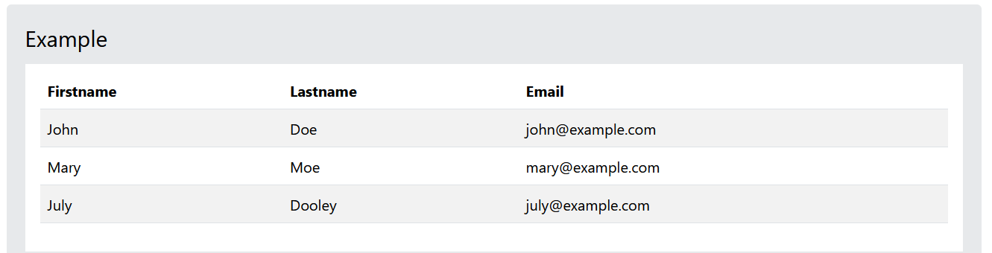
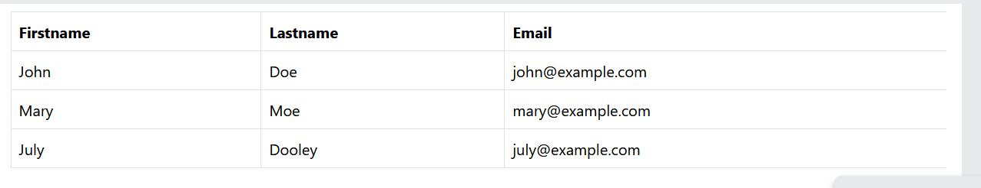
Striped Rows & Bordered Table
The .table-striped class adds zebra-stripes to a table:
<table class="table table-striped">
The .table-bordered class adds borders on all sides of the table and cells:
<table class="table table-bordered">

Slide 62
Hover Rows
The .table-hover class enables a hover state (grey background on mouse over) on table rows
<table class="table table-hover">
Black/Dark Table
The .table-dark class adds a black background to the table:
<table class="table table-dark table-hover"> //combining hover and dark table
Borderless Table
The .table-borderless class removes borders from the table

Slide 63
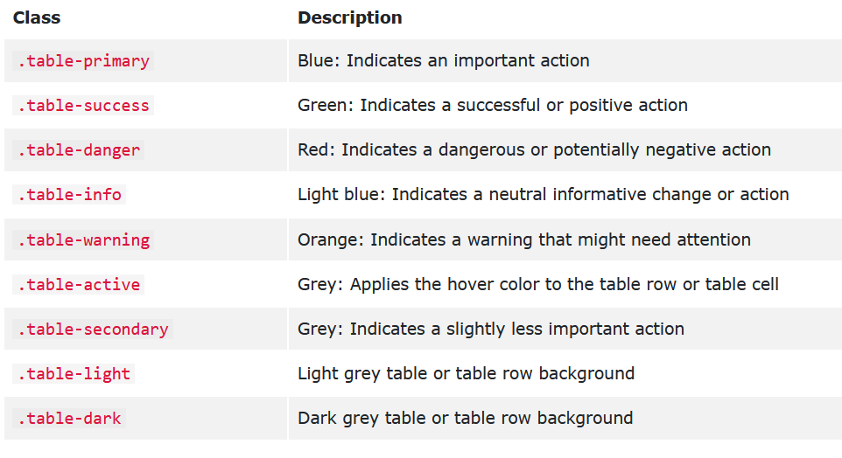
Variants
Use contextual classes to color tables, table rows or individual cells.

Slide 64
<table class="table-primary">...</table>
<tr class="table-primary">...</tr>
<td class="table-primary">...</td>
Active tables
Highlight a table row or cell by adding a .table-active class
Small table
The .table-sm class makes the table smaller by cutting cell padding in half:

Slide 65
Responsive Tables
The .table-responsive class adds a scrollbar to the table when needed (when it is too big horizontally):
<div class="table-responsive">
<table class="table">
...
</table>
</div>

Slide 66
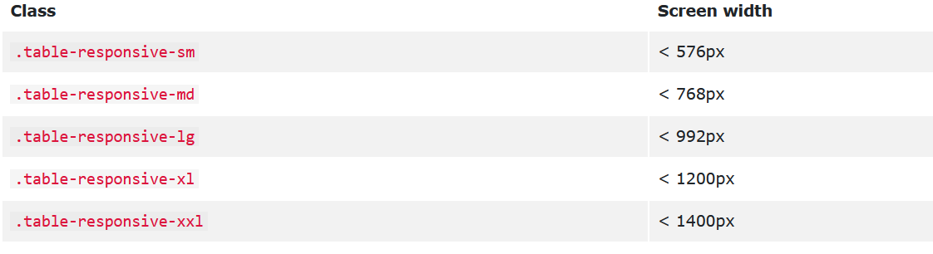
Responsive Tables
You can also decide when the table should get a scrollbar, depending on the screen width:
<div class="table-responsive-sm">

Slide 67
Vertical alignment
Table cells of <thead> are always vertical aligned to the bottom.
Table cells in <tbody> inherit their alignment from <table> and are aligned to the the top by default.
Use the vertical align classes to re-align where needed.
align-middle
align-bottom
align-top
<table class="table align-middle">
<tr class="align-bottom">
<td class="align-top">

Slide 68
Nesting
Border styles, active styles, and table variants are not inherited by nested tables. Captions
CAPTIONS
A <caption> functions like a heading for a table. It helps users with screen readers to find a table and understand what it’s about and decide if they want to read it.
<caption>……….</caption>
You can also put the <caption> on the top of the table with .caption-top.
<table class="table caption-top">
<caption>List of users</caption>

Slide 69
List
List groups are a flexible and powerful component for displaying a series of content. Modify and extend them to support just about any content within.
The most basic list group is an unordered list with list items:
To create a basic list group, use an <ul> element with class .list-group, and <li> elements with class .list-group-item:
<ul class="list-group">
<li class="list-group-item">First item</li>
<li class="list-group-item">Second item</li>
<li class="list-group-item">Third item</li>
</ul>

Slide 70
List-Badges
We can also add badges to a list group. The badges will automatically be positioned on the right:
To create a badge, create a <span> element with class .badge inside the list item
<ul class="list-group">
<li class="list-group-item">New <span class="badge">12</span></li>
</uI>

Slide 71
List Group With Linked Items
The items in a list group can also be hyperlinks. This will add a grey background color on hover:
<div class="list-group"> <a href="#" class="list-group-item">First item</a> <a href="#" class="list-group-item">Second item</a> <a href="#" class="list-group-item">Third item</a> </div>
To create a list group with linked items, use <div> instead of <ul> and <a> instead of <li>

Slide 72
Active State
Use the .active class to highlight the current item:
<ul class="list-group">
<li class="list-group-item active">Cras justo odio</li>
</uI>
Disabled item
To disable an item, add the .disabled class:
<li class="list-group-item disabled">Cras justo odio</li>

Slide 73
Buttons
With <button>s, you can also make use of the disabled attribute instead of the .disabled class
<div class="list-group">
<button type="button" class="list-group-item list-group-item-action active" aria-current="true">
The current button
</button>
<button type="button" class="list-group-item list-group-item-action">A fourth button item</button>
<button type="button" class="list-group-item list-group-item-action" disabled>A disabled button item</button>
</div>

Slide 74
Flush
Add .list-group-flush to remove some borders and rounded corners to render list group items edge-to-edge in a parent container
<ul class="list-group list-group-flush">
Contextual Classes
Contextual classes can be used to color list items:
The classes for coloring list-items are: .list-group-item-success, list-group-item-info, list-group-item-warning, and .list-group-item-danger:
And all the contextual classes defined in tables

Slide 75
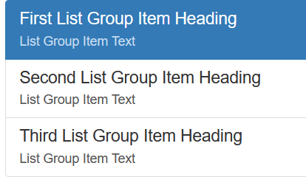
Custom content
Bootstrap provides the classes .list-group-item-heading and .list-group-item-text which can be used as follows:
<div class="list-group">
<a href="#" class="list-group-item active">
<h4 class="list-group-item-heading">First List Group Item Heading</h4>
<p class="list-group-item-text">List Group Item Text</p>
</a>
………….
</div>

Slide 76
Unstyled
This is a list and it appears completely unstyled.
Structurally, it's still a list.However, this style only applies to immediate child elements.
Nested lists:
are unaffected by this style
will still show a bullet
and have appropriate left margin
<ul class="list-unstyled">

Slide 77
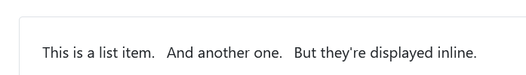
Inline
Remove a list’s bullets and apply some light margin with a combination of two classes, .list-inline and .list-inline-item.
<ul class="list-inline">
<li class="list-inline-item">This is a list item.</li>
<li class="list-inline-item">And another one.</li>
<li class="list-inline-item">But they're displayed inline.</li>
</ul>

Slide 78
Numbered
Add the .list-group-numbered modifier class (and optionally use an <ol> element) to opt into numbered list group item
<ol class="list-group list-group-numbered">

Slide 79
Checkboxes and radios
Place Bootstrap’s checkboxes and radios within list group items and customize as needed. You can use them without <label>s, but please remember to include an aria-label attribute and value for accessibility.
<ul class="list-group">
<li class="list-group-item">
<input class="form-check-input me-1" type="checkbox" value="" aria-label="...">
First checkbox
</li>

Slide 80
Cards
A card is a flexible and extensible content container.
It includes options for headers and footers, a wide variety of content, contextual background colors, and powerful display options
Cards are built with as little markup and styles as possible, but still manage to deliver a ton of control and customization.
They have no margin by default, so use spacing utilities as needed.

Slide 81
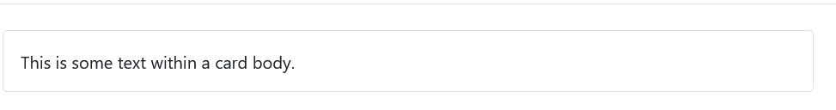
Content types
Cards support a wide variety of content, including images, text, list groups, links, and more.
Body
The building block of a card is the .card-body. Use it whenever you need a padded section within a card.
<div class="card">
<div class="card-body">
This is some text within a card body.
</div>
</div>

Slide 82
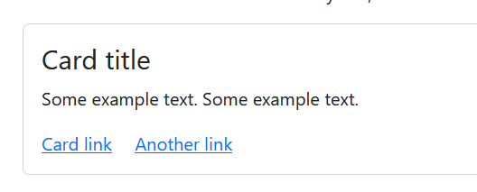
Titles, text, and links
Use .card-title to add card titles to any heading element.
With .card-text, text can be added to the card. Text within .card-text can also be styled with the standard HTML tags.
The .card-link class adds a blue color to any link, and a hover effect.
Instead of this card link you can use buttons class=“btn” also
<div class="card"> <div class="card-body"> <h4 class="card-title">Card title</h4> <p class="card-text">Some example text. Some example text.</p> <a href="#" class="card-link">Card link</a> </div> </div>

Slide 83
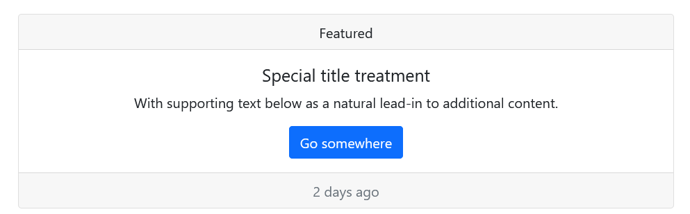
Header and Footer
The .card-header class adds a heading to the card and the .card-footer class adds a footer to the card:
<div class="card">
<div class="card-header">Header</div>
<div class="card-body">Content</div>
<div class="card-footer">Footer</div>
</div>

Slide 84
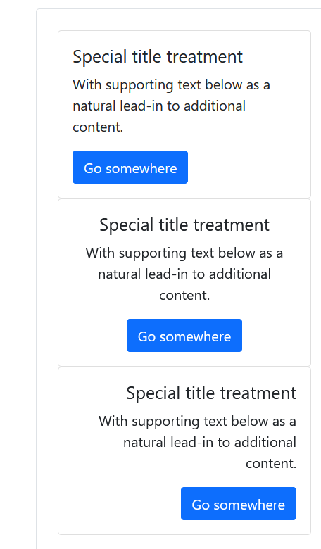
Text alignment
<div class="card" style="width: 18rem;">
<div class="card text-center" style="width: 18rem;">
<div class="card text-end" style="width: 18rem;">

Slide 85
Contextual Cards
To add a background color to the card, use contextual classes (.bg-primary, .bg-success, .bg-info, .bg-warning, .bg-danger, .bg-secondary, .bg-dark and .bg-light.
<div class="card bg-primary text-white">

Slide 86
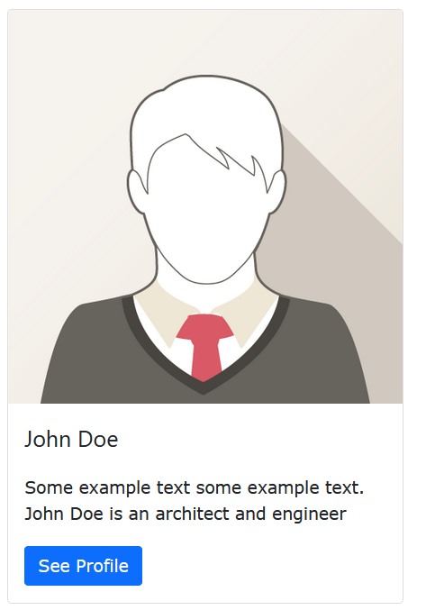
Card Images
Add .card-img-top or .card-img-bottom to an <img> to place the image at the top or at the bottom inside the card.
Note that we have added the image outside of the .card-body to span the entire width:
<div class="card" style="width:400px"> <img class="card-img-top" src="img_avatar1.png" alt="Card image"> <div class="card-body">
…….

Slide 87
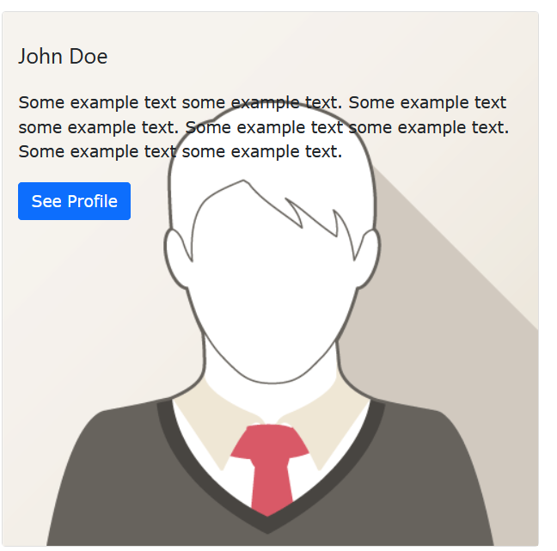
Card Image Overlays
Turn an image into a card background and use .card-img-overlay to add text on top of the image:
<div class="card" style="width:500px"> <img class="card-img-top" src="img_avatar1.png" alt="Card image"> <div class="card-img-overlay">

Slide 88
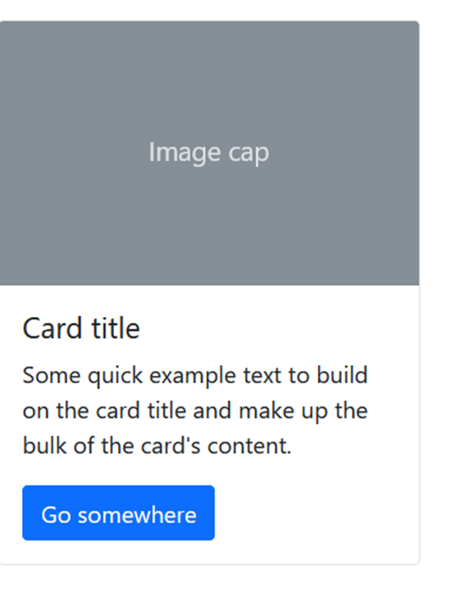

Slide 89
<div class="card" style="width: 18rem;">
<img src="..." class="card-img-top" alt="...">
<div class="card-body">
<h5 class="card-title">Card title</h5>
<p class="card-text">Some quick example text to build on the card title and make up the bulk of the card's content.</p>
<a href="#" class="btn btn-primary">Go somewhere</a>
</div>
</div>

Slide 90
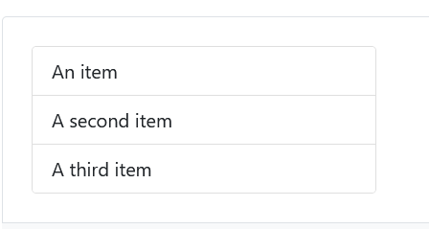
List groups
Create lists of content in a card with a flush list group.
<div class="card" style="width: 18rem;">
<ul class="list-group list-group-flush">
<li class="list-group-item">An item</li>
<li class="list-group-item">A second item</li>
<li class="list-group-item">A third item</li>
</ul>
</div>

Slide 91
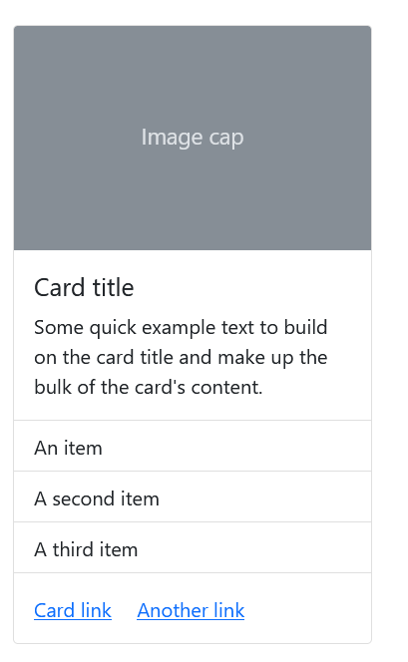
Kitchen sink
Mix and match multiple content types to create the card you need, or throw everything in there. Shown below are image styles, blocks, text styles, and a list group—all wrapped in a fixed-width card.

Slide 92
<div class="card" style="width: 18rem;">
<img src="..." class="card-img-top" alt="...">
<div class="card-body">
<h5 class="card-title">Card title</h5>
<p class="card-text">Some quick example text to build on the card title and make up the bulk of the card's content.</p>
</div>
<ul class="list-group list-group-flush">
<li class="list-group-item">An item</li>
<li class="list-group-item">A second item</li>
<li class="list-group-item">A third item</li>
</ul>
<div class="card-body">
<a href="#" class="card-link">Card link</a>
<a href="#" class="card-link">Another link</a>
</div>
</div>

Slide 93
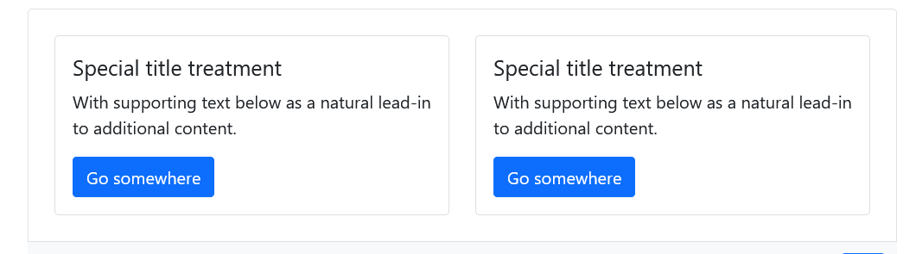
Sizing
Cards assume no specific width to start, so they’ll be 100% wide unless otherwise stated.
You can change this as needed with custom CSS, grid classes, grid Sass mixins, or utilities.
Custom CSS- <div class="card" style="width: 18rem;">
Using grid markup-Using the grid, wrap cards in columns and rows as needed.

Slide 94
<div class="row">
<div class="col-sm-6">
<div class="card">
<div class="card-body">
………..
</div>
</div>
</div>
<div class="col-sm-6">
<div class="card">
<div class="card-body">
………………
</div>
</div>
</div>
</div>

Slide 95
Using utilities
Use our handful of available sizing utilities to quickly set a card’s width.
<div class="card w-75">

Slide 96
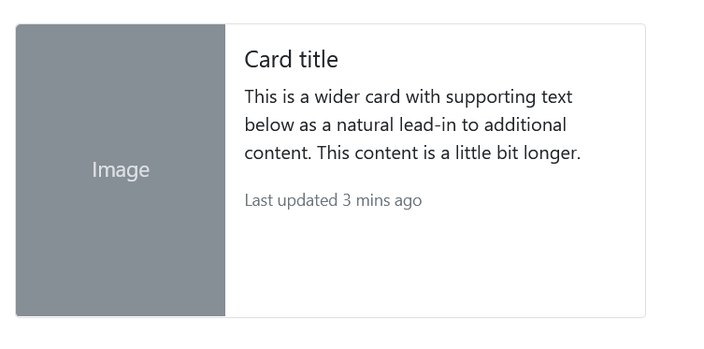
Horizontal
Using a combination of grid and utility classes, cards can be made horizontal in a mobile-friendly and responsive way.
In the example below, we remove the grid gutters with .g-0 and use .col-md-* classes to make the card horizontal at the md breakpoint. Further adjustments may be needed depending on your card content.
<div class="card mb-3" style="max-width: 540px;">
<div class="row g-0">
<div class="col-md-4">
<img src="..." class="img-fluid rounded-start" alt="...">
</div>
<div class="col-md-8">

